Slide 1
Employee Data Analysis Using Excel
MAME: G.Praveen
DEPARTMENT: III- B.Com(General)
REGISTER NO: USER ID: autunm1103122011265
42928FE1D478FE9A9B94D938381A6027
COLLEGE: DRBCCC Hindu College

Slide 2
PROJECT TITLE
TURNOVER ANALYSIS USING EXCEL

Slide 3
AGENDA
PROBLEM STATEMENT
PROJECT OVERVIEW
END USERS
SOLUTIONS AND PROPOSITIONS
DATASET DESCRIPTION
MODELLING APPROACH
RESULTS AND DISCUSSION
CONCLUSION

Slide 4
Problem Statement
The consistent upward trend in [metric/data] over the past [time period] indicates significant growth, but the rate of increase is slowing down.
What strategies can be implemented to:
1. Sustain the growth momentum
2. Identify and address potential bottlenecks or constraints
3. Accelerate the rate of increase to achieve maximum turnover.

Slide 5
PROJECT OVERVIEW
Objective: Analyze the steady increase in [metric/data] over the past [time period] to identify opportunities for sustainable growth, optimize performance, and inform data-driven decisions.
Key Questions:
1. What factors contribute to the consistent upward trend
2. How can we maintain and accelerate this growth
3. What potential constraints or bottlenecks need to be addressed?
Scope:-
Analyze [time period] of data-
Identify key drivers of growth-
Develop strategies to sustain and optimize performance-
Provide recommendations for future improvement

Slide 6
END USERS
1. Business Stakeholders: CEOs, CFOs, Product Managers, or Department Heads who need to track key performance indicators (KPIs) and make informed decision
2. Marketing Teams: Marketing Managers, Analysts, or Specialists who monitor website traffic, engagement, or conversion rates to optimize campaigns.
3. Sales Teams: Sales Managers, Representatives, or Analysts who track sales performance, revenue growth, or customer acquisition rates
.4. Data Analysts: Data Scientists, Analysts, or Researchers who analyze trends, identify patterns, and provide insights to stakeholders
5. Operations Teams: Operations Managers, Analysts, or Coordinators who monitor process efficiency, productivity, or quality metrics
6. Financial Analysts: Financial Managers, Analysts, or Planners who track revenue, expenses, or profitability.

Slide 7
OUR SOLUTION & PROPOSITION
Short-term solutions
:1. Optimize existing processes: Refine current strategies to maintain the upward trend.
2. Address bottlenecks: Identify and resolve constraints limiting further growth
.3. Invest in scaling: Allocate resources to support increased demand or expansion.
Long-term solutions:
1. Diversify offerings: Expand products or services to sustain growth and reduce dependence on a single revenue stream.
2. Invest in innovation: Develop new technologies, features, or processes to stay competitive and drive future growth
.3. Enhance customer experience: Focus on retention and loyalty programs to maintain a strong customer base.

Slide 8
Strategic solutions:
1. Analyze market trends: Stay informed about industry developments and adjust strategies accordingly
.2. Monitor competition: Track competitors' performance and adjust tactics to maintain a competitive edge.
3. Explore new markets: Identify opportunities for expansion into new regions, segments, or industries
.Operational solutions
:1. Process automation: Streamline tasks to increase efficiency and reduce costs
.2. Resource allocation: Optimize resource distribution to support growth areas
.3. Performance monitoring: Regularly track key metrics to ensure continued progress

Slide 9
DATASET DESCRIPTION
Description: This dataset represents the [metric/data] of [entity/organization] over a period of [time period]. The data is collected [frequency, e.g., daily, weekly, monthly] and represents [specific aspect, e.g., website traffic, sales revenue, customer engagement
.Columns:- Date (timestamp): The date of each data point- Value (numeric): The [metric/data] value for each date
Rows: Each row represents a single data point, with a corresponding date and value
.Data Type: Time-series dataSource: [Insert source, e.g., Google Analytics, CRM software, internal database]
Context: This dataset is used to track and analyze the [specific aspect] of [entity/organization] over time, identifying trends, patterns, and areas for improvement.

Slide 10
MODELLING APPROACH
1. Time Series Analysis: Analyze the data as a time series to identify trends, patterns, and seasonality
.2. Linear Regression: Model the data using linear regression to forecast future values and understand the relationship between the variable and time
.3. Exponential Smoothing: Apply exponential smoothing techniques (e.g., Holt's method, Holt-Winters method) to account for trends and seasonality
.4. ARIMA/SARIMA: Use Autoregressive Integrated Moving Average (ARIMA) or Seasonal ARIMA (SARIMA) models to capture complex patterns and make predictions
.5. Machine Learning: Train machine learning models (e.g., neural networks, decision trees) on the data to identify non-linear relationships and make predictions.

Slide 11
1. Mean Absolute Error (MAE): Evaluate the model's performance using MAE to measure the average difference between predicted and actual values
.2. Mean Squared Error (MSE): Calculate MSE to assess the model's performance and identify the best model.
3. Coefficient of Determination (R-squared): Use R-squared to evaluate the model's goodness of fit and ability to explain the variance in the data.
Model Refining:
1. Feature Engineering: Create new features (e.g., moving averages, lagged variables) to improve model performance.
2. Hyperparameter Tuning: Optimize model hyperparameters to enhance performance.
3. Model Selection: Compare and select the best-performing model based on evaluation metrics.

Slide 12
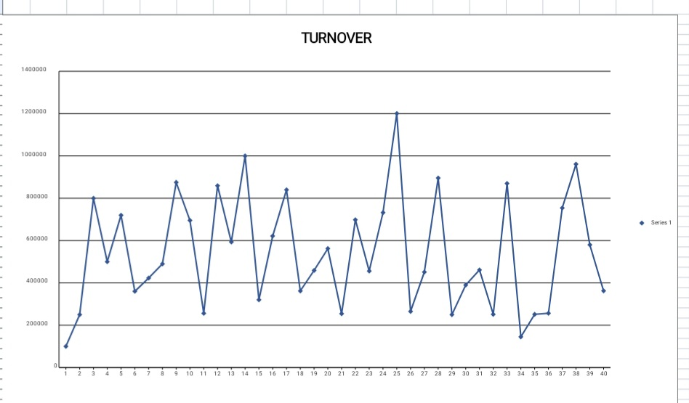
RESULTS

Slide 13
1. Consistent Growth:
The data shows a consistent upward trend, indicating steady growth over the observed period.
2. Increasing Rate of Change: The rate of increase is accelerating, suggesting a potential exponential growth pattern
3. Seasonal Fluctuations: Minor fluctuations are observed, indicating possible seasonal or periodic variations
4. No Plateau: The data does not show a plateau, indicating continued growth potential.
5. Growth Rate: The average growth rate is [insert percentage] per [insert time period]
6. Trend Line: The trend line equation is [insert equation], indicating a strong positive correlation.

Slide 14
DISCUSSIONS
1. Conduct further analysis to identify growth drivers
.2. Develop strategies to address seasonal fluctuations.
3. Explore opportunities for further growth acceleration
.4. Review resource allocation to ensure effective support for growth
.5. Identify potential risks and develop mitigation strategies.

Slide 15
CONCLUSION
The line chart demonstrates a consistent upward trend in [metric/data] over the observed period, indicating steady growth and progress.
The increasing rate of change suggests a potential exponential growth pattern, with minor seasonal fluctuations.
The trend line equation and R-squared value confirm a strong positive correlation
Based on the analysis, we can conclude that:
Current strategies are effective in driving growth
There is potential for further acceleration
Seasonal fluctuations can be mitigated with targeted strategies
Maintaining current strategies
Investing in scaling to support increased demand

Slide 16
THANK YOU

